Slide 1
Dancing With Uncertainty
By: Sasa Misailovic, Stelios Sidiroglou, Martin Rinard
Presented by Stephen Young

Slide 2
DubStep
A novel system that explores new parallelization optimizations for already parallel programs.
The system explores transformations that create tradeoffs between accuracy of results and increased speedup in performance.
Dubstep utilizes a three step method Find, Transform, Navigate for discovering new parallelizations.

Slide 3
Find
Dubstep starts by running the original program and analyzing the performance metrics, execution parameters, and memory allocation.
Identifies regions of parallel code where the program spends the largest percentage of execution time.
Identifies regions of memory with low contention and relaxes synchronization overhead around those areas.

Slide 4
Transform
Opportunistic Synchronization
Replaces synchronized blocks with un-synchronized blocks by removing locks.
This is only done when the subsequent data races do not severely affect program results.
Opportunistic Barriers
Traditional synchronization barriers require all threads to reach the barrier before allowing them to continue executing.
Dubstep only requires a fraction of the threads to reach the barrier. Any threads that are still executing are halted and forced to proceed past the barrier.
The transformations are analyzed for performance and accuracy metrics. They are also tested for program crashing errors.

Slide 5
Navigate
The first transformations create a larger transformation space with more opportunities for relaxed synchronization.
Given a small enough space, Dubstep can perform an exhaustive search on all potential transformations. If the transformation space is large, a two step exploration algorithm is used.
During the initial transformation phase, each transformation goes through a performance, safety, and accuracy test. If it fails one of the tests, the transformation is not used as a potential source for future transformations.

Slide 6
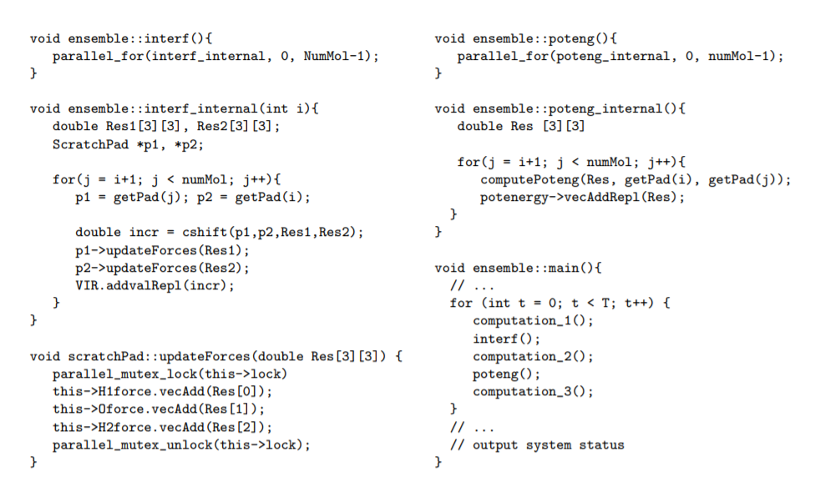
Example - Water

Slide 7
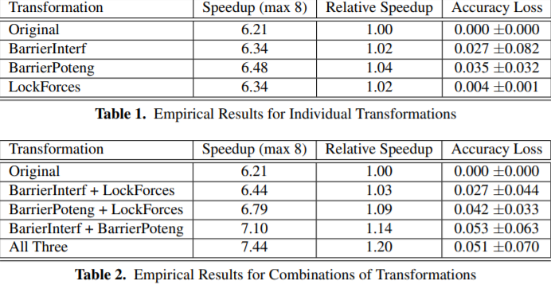
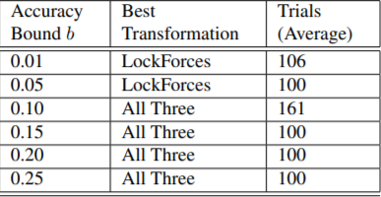
Dubstep identified that the program spent 99.7% of the total execution time inside of two functions. Making them good candidates for transformation.
Opportunistic barriers were used on both functions, with only half of the threads having to reach the barrier for all other threads to terminate computation and proceed past it.
Synchronization was relaxed in functions that did not have high memory traffic.

Slide 8
Reliability
The reliability of a transformation is the probability that the output is within the specified error bound b.
The user specifies a reliability that a transformation must meet to be an acceptable candidate.
In the previous example, the reliability threshold is 0.9.

Slide 9
Questions?

